Slide 1
Secure Data Hiding in Image Using Steganography
CAPSTONE PROJECT
Presented By: Sanku Srinivas
College Name & Department : Aurora’s PG College, MCA

Slide 2
OUTLINE
Problem Statement
Technology used
Wow factor
End users
Result
Conclusion
Git-hub Link
Future scope

Slide 3
Problem Statement
With the rise of cyber threats, securing sensitive information is a major concern. Traditional encryption methods can be detected, making them vulnerable. This project uses Image Steganography to hide secret messages inside images, ensuring undetectable and secure communication.

Slide 4
Technology used
Programming Language: Python
GUI Framework: Tkinter
Libraries Used: OpenCV, NumPy
Encryption & Decryption: Bit Manipulation & LSB (Least Significant Bit) technique
File Handling: Reading & Writing PNG image formats

Slide 5
Wow factors
Secret Message Hiding – Embeds messages within images without visible changes.
User-Friendly GUI – Easy-to-use interface with buttons for encryption & decryption.
Password Protection – Ensures only authorized users can extract hidden messages.
No Internet Required – Works entirely offline for enhanced security.
Real-time Image Processing – Fast and efficient message embedding and retrieval.

Slide 6
End users
Cybersecurity Enthusiasts – For secure offline message hiding.
Government & Defence – Secure sensitive data without raising suspicion.
Journalists & Activists – Safe transmission of confidential data.
Educational Purposes – Understanding steganography & encryption techniques.
General Users – Anyone who needs a private message storage method.

Slide 7
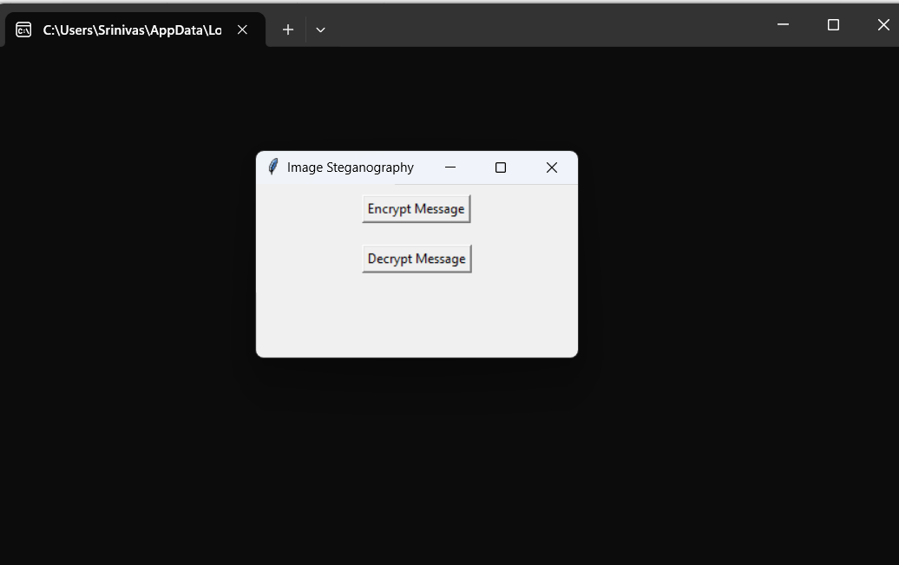
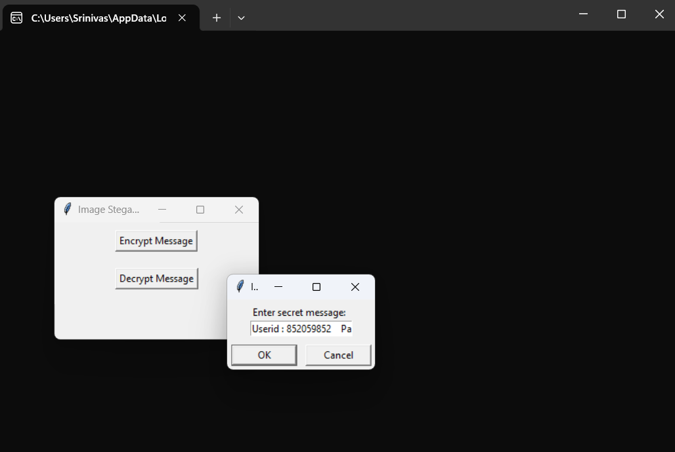
Results

Slide 8
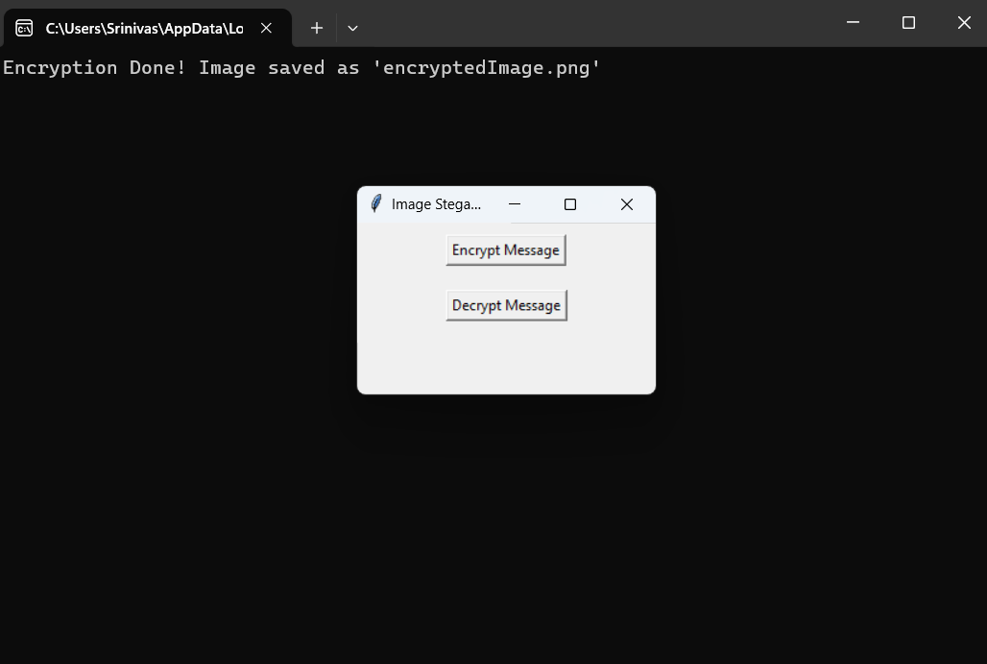
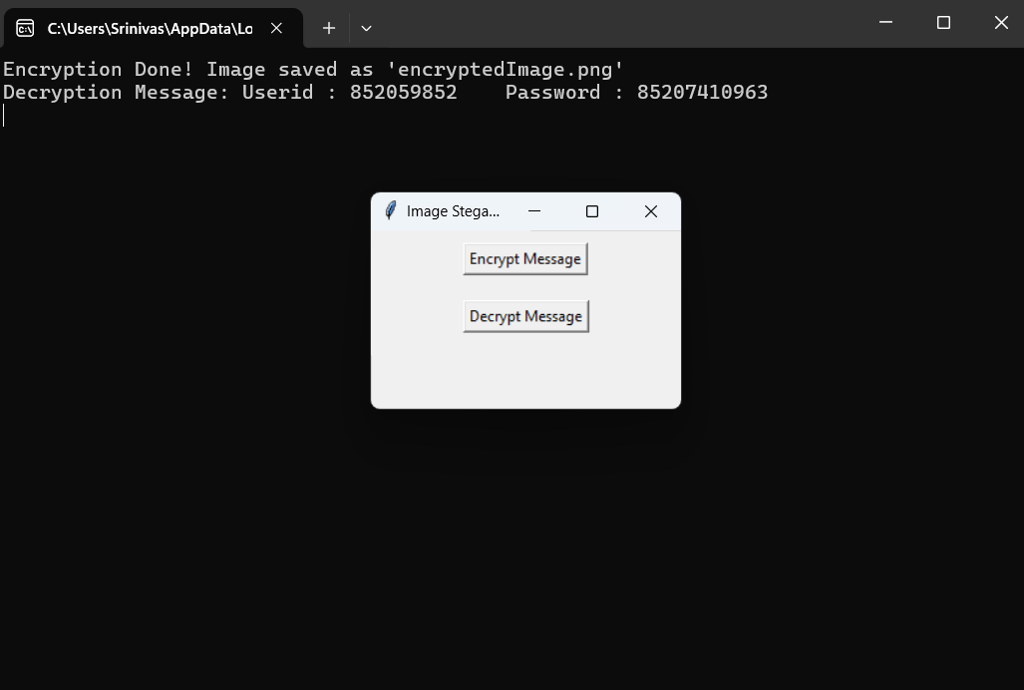
Results

Slide 9
Conclusion
This project implements Image Steganography using Python and Tkinter, enabling users to securely hide and retrieve messages inside images. The graphical interface (GUI) provides an interactive and easy-to-use experience. Password protection ensures only authorized users can extract messages, enhancing security

Slide 10
GitHub Link
https://github.com/ssrinivas-19/Image-Steganography-.git

Slide 11
Future scope
AES Encryption Integration – Additional security for messages.
Image Format Expansion – Support for JPEG, BMP, etc.
Steganalysis Detection Prevention – Enhancing security against detection.
Mobile & Desktop App – Developing for Android, iOS, and Windows.

Slide 12
THANK YOU

